Slide 1
Game AI
Project 3: Behavior Programming
Alina Arunova
Phil Matyash
Marina Mircheska
Aditya Kela
Sattar Rahimbeyli
Notes:
<number>

Slide 2
Outline
Tic Tac Toe tree calucaltion
Minmax computations
Minmax search for connect four
Breakout predictor
Path planning
Notes:
<number>

Slide 3
Task 2.1:
Notes:
<number>

Slide 4
Task 2.1:
Notes:
<number>

Slide 5
Task 2.1:
Notes:
<number>

Slide 6
Task 2.1:
Notes:
<number>

Slide 7
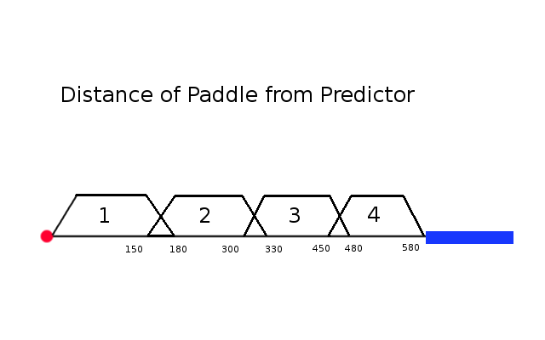
Task 2.2: Fuzzy Controller for Breakout
The maximum distance (= 580 units) between the
Paddle and the Predictor ball is divided into 4 rules
Notes:
<number>

Slide 8
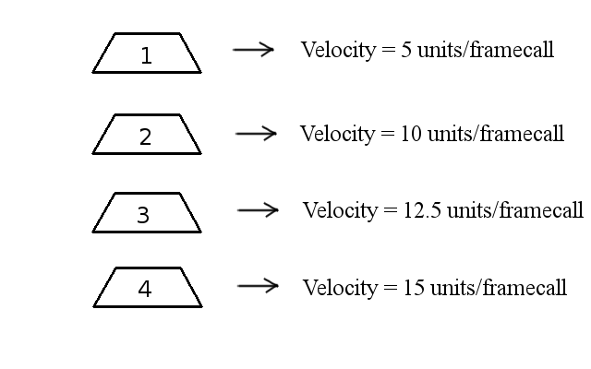
Task 2.2: Fuzzy Controller for Breakout
The rule set for the
divided distance is:
Notes:
<number>

Slide 9
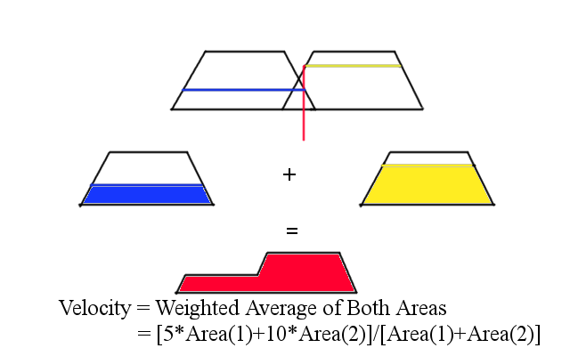
Task 2.2: Fuzzy Controller for Breakout
If the distance between
the predictor ball and the paddle leads to two rules
firing, then the velocity function is the weighted average:
Notes:
<number>

Slide 10
Task 2.3:
Notes:
<number>

Slide 11
Task 2.3:
Notes:
<number>

Slide 12
Task 2.3:
Notes:
<number>

Slide 13
Task 2.3:
Notes:
<number>

Slide 14
Task 2.4:
Notes:
<number>

Slide 15
Task 2.4:

Slide 16
Task 2.4:
Notes:
<number>

Slide 17
Task 2.4:

